Slide 1
Bazele inteligenței artificiale
Laborator – Grigore Ionuț

Slide 2


today’s lab

Slide 3
Content
Linear regression in PyTorch
The FashionMNIST dataset
Softmax regression in PyTorch
Multilayer perceptrons
Weight decay
Dropout
Deep learning computation

Slide 4
1) Linear regression in PyTorch

Slide 5
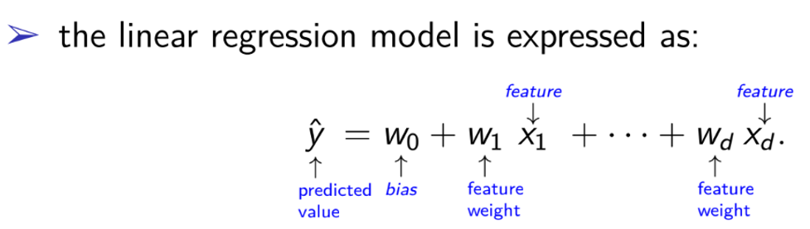
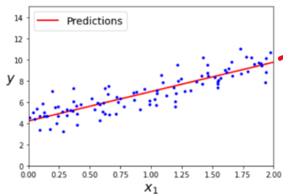
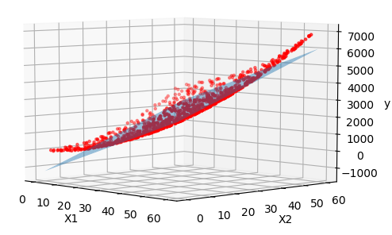


d=2
d=3
equation of a line
equation of a plane
NOTE:
We cannot plot more than 3 dimensions ! ☺ (actually we can but it’s more tricky)

Slide 6
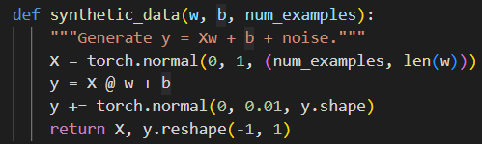










features
Basically here we created:
w₀ (or b)
w₁
w₂
noise
labels
Now we want to apply Linear Regression to find these values: w₀ (or b – bias), w₁, w₂ !

Slide 7
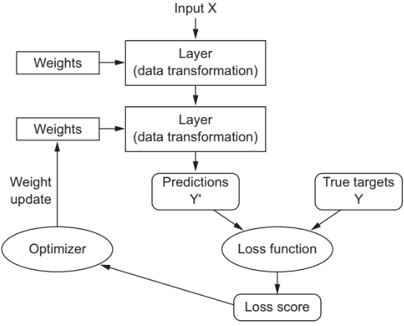
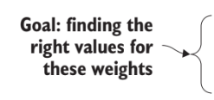

DL model

Slide 8
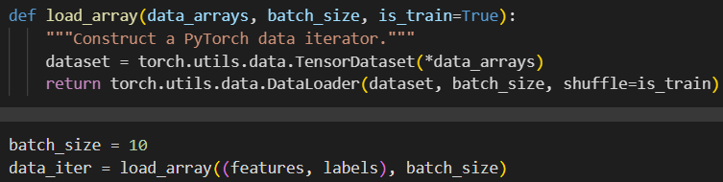


Steps
construct the dataset, shuffle the dataset and access it in mini-batches:
define the linear regression model:
initialize the parameters:
specify the loss function to be used:
we will discuss later about it
2 because we have 2 inputs (x₁, x₂)
1 because we have 1 output (y)

Slide 9


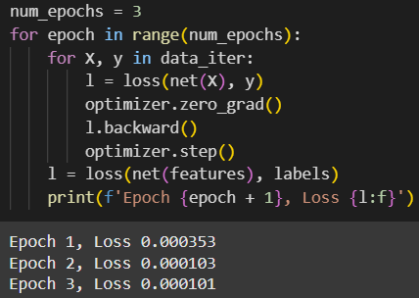

Steps
NOTE:
specify the optimizer to be used:
generate predictions (net(X)) and compute the loss (forward propagation)
calculate gradients by running the backpropagation using backward() on the loss
update the model parameters using optimizer.step():
compute the loss after each epoch and print it to the monitor:
NOTE:
this operation is essential to avoid accumulating gradients from previous operations
in PyTorch, the gradients are accumulated (summed up) by default in the .grad attribute of tensors whenever backward() is called
this is helpful for cases where you want to accumulate gradients across multiple operations, but it can lead to incorrect or unintended results if you're not explicitly aiming for that

Slide 10
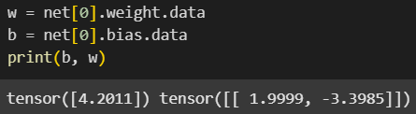
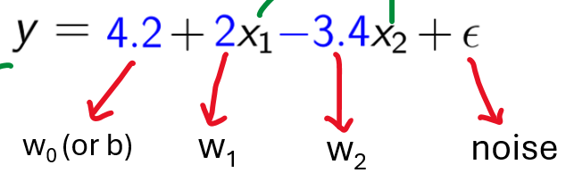



Result:
Our true w and b:

Slide 11
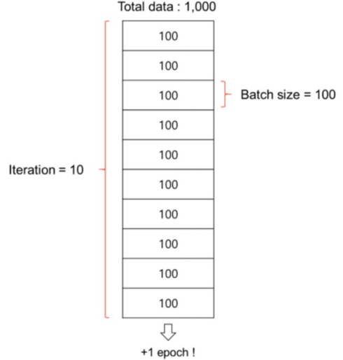
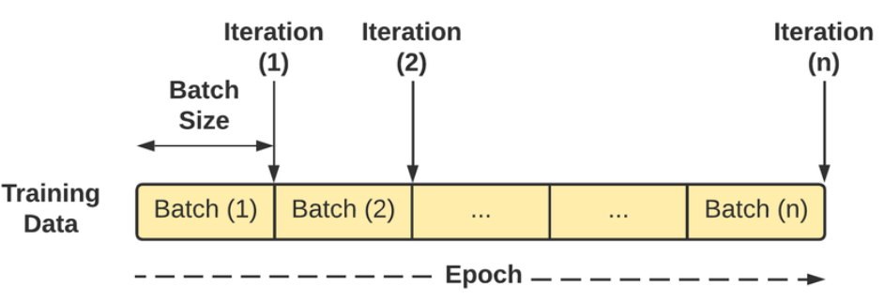
Kind reminder
a batch is a subset of the training dataset used to calculate the loss and update the model parameters during one forward and backward pass
an iteration is one step of training where a single batch is processed
an epoch is a complete pass through the entire training dataset

Slide 12
2) The FashionMNIST dataset

Slide 13
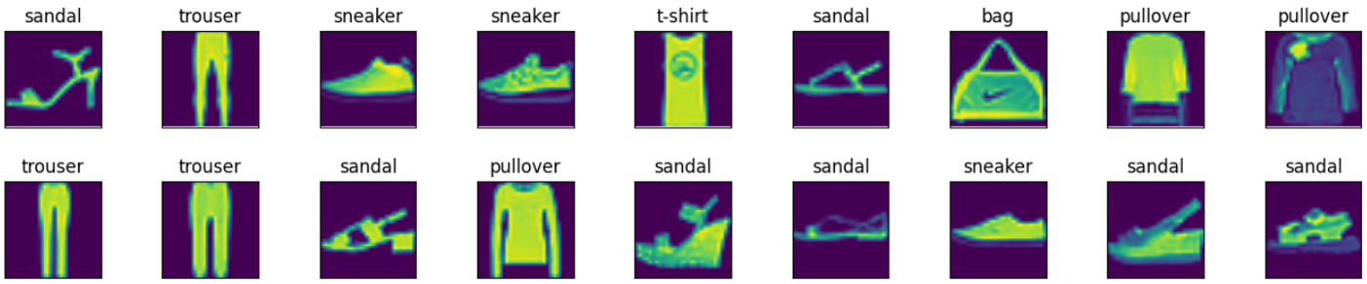
description: a dataset of 70,000 grayscale images of clothing items, with 10 classes (e.g., T-shirt, trousers, etc.):
      training set: 60,000 images
      test set: 10,000 images
image size: each image is 28×28 pixels
classes:
      1. T-shirt/top
      2. Trouser
      3. Pullover
      4. Dress
      5. Coat
      6. Sandal
      7. Shirt
      8. Sneaker
      9. Bag
      10. Ankle boot

Slide 14
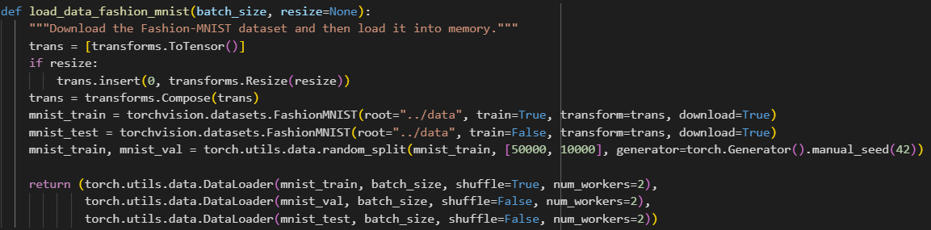
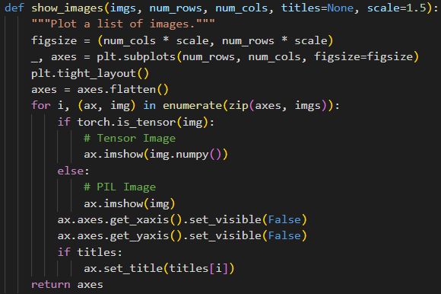
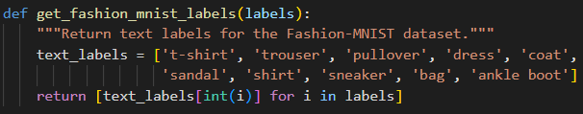

converts the image data from PIL type to 32-bit floating point tensors
divides all numbers by 255, so that all pixel values are between 0 and 1
NOTE: functions already done in lab, just use them as they are ☺

Slide 15
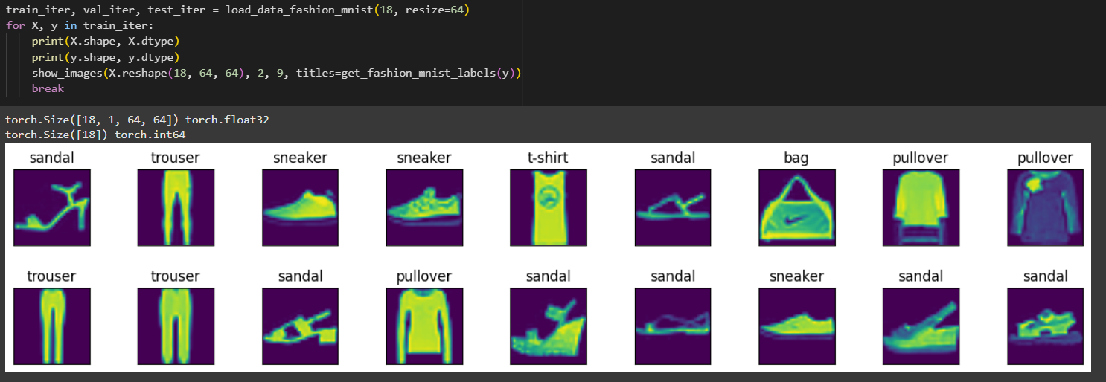
Here are the images and their corresponding labels (in text) for the first few (18) examples in the training dataset:

Slide 16
3) Softmax regression in PyTorch

Slide 17
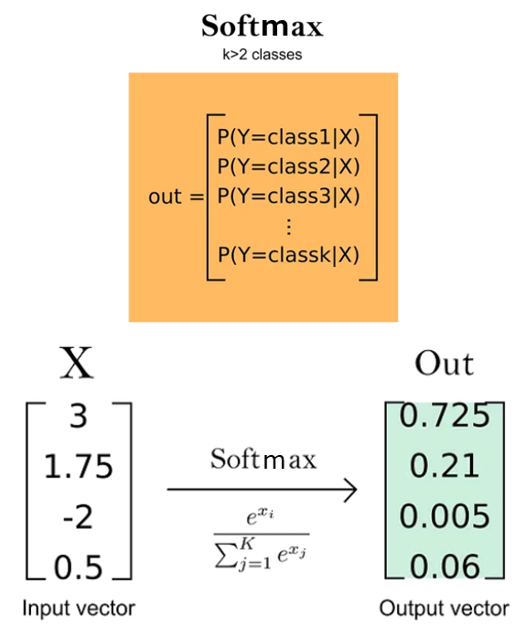

the goal of applying softmax regression to the FashionMNIST dataset is to classify each image into one of 10 distinct clothing categories
It determines the probability of an image belonging to each class and assigns the label with the highest probability
the highest probability !

Slide 18
DL model

Slide 19
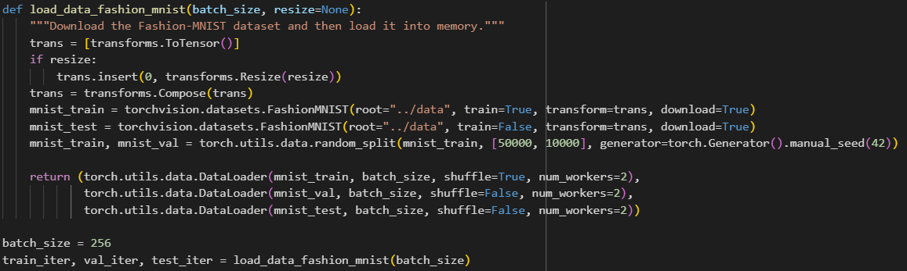
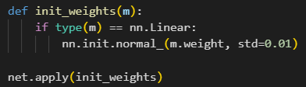


Steps
construct the Fashion-MNIST dataset and access it in mini-batches:
define the softmax regression model:
initialize the parameters:
we will discuss later about it
784 because we have 28×28 inputs (each image is flattened to a vector)
10 because we have 10 outputs (1 probability for each of the 10 classes)

Slide 20

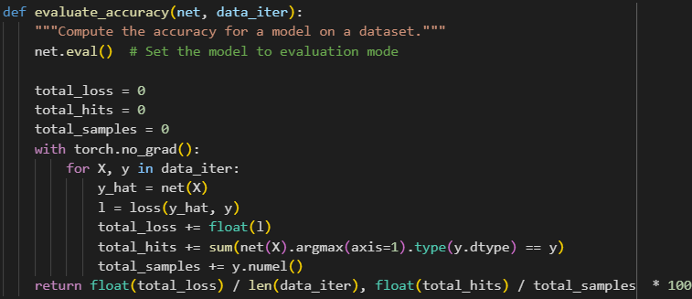

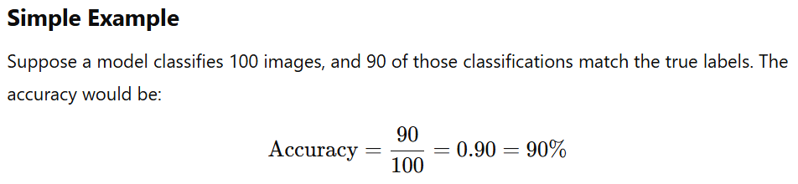
Steps
specify the loss function to be used:
specify the optimizer to be used:
use the evaluate_accuracy() function which is already done in lab:

Slide 21
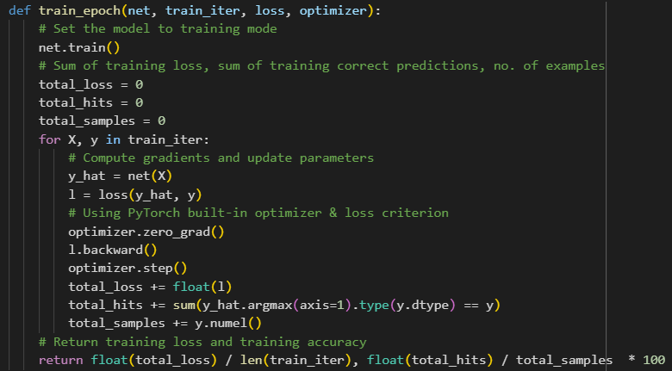
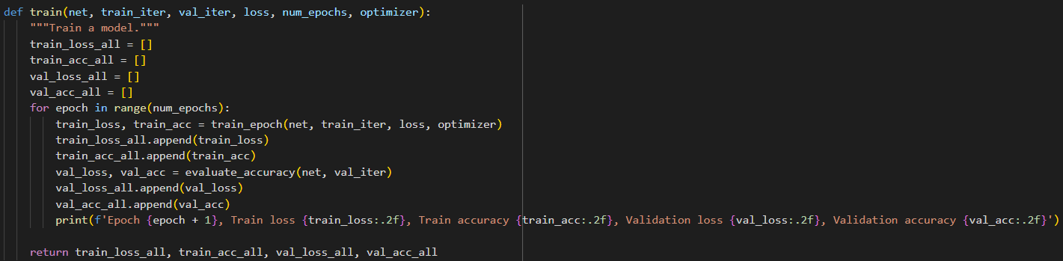
Steps
use train_epoch() function which is already done in lab:
use train() function which is already done in lab:
train the model for 1 epoch
train the model for multiple epochs, specified by num_epochs

Slide 22
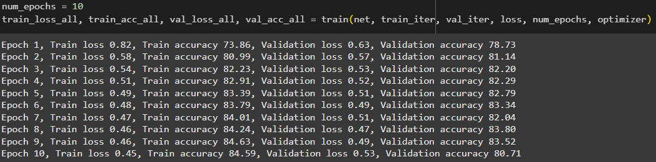

Steps
train the model for 10 epochs by running train() function:

Slide 23
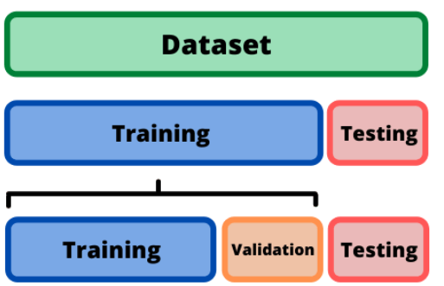
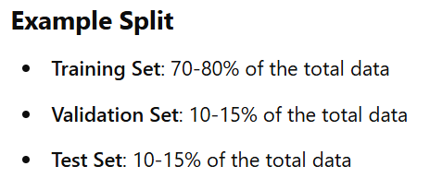
Training/validation/test split
In ML/DL, datasets are typically divided into 3 parts: training, validation, and test sets (in the first part we worked just with training and test !)

Slide 24
Training/validation/test split
Training Set
  Purpose: is the subset of data used to train the ML/DL model.
  What Happens: during training, the model adjusts its parameters (e.g., weights in neural networks) using algorithms like gradient descent to optimize a specific objective function, such as minimizing loss
  Size: usually the largest portion of the dataset to ensure the model has enough data to learn from
Validation Set
  Purpose: is used to fine-tune the model and evaluate its performance during training. It acts as an independent dataset to monitor how well the model generalizes to unseen data.
  What Happens:
    it helps detect overfitting or underfitting
    used to tune hyperparameters (e.g., learning rate, number of layers, dropout rate)
  Size: typically a smaller portion of the dataset than the training set, often split from the original data
Test Set
  Purpose: is an entirely separate dataset used to assess the final performance of the trained model. It provides an unbiased evaluation of the model's ability to generalize to new data
  What Happens:
    it simulates how the model will perform in real-world scenarios
    no training or fine-tuning should happen on the test set to ensure a fair evaluation
  Size: similar in size to the validation set, but this depends on the size of the overall dataset

Slide 25
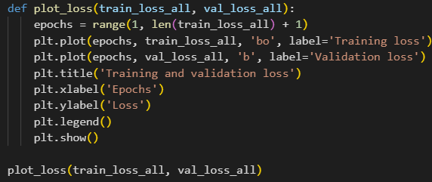
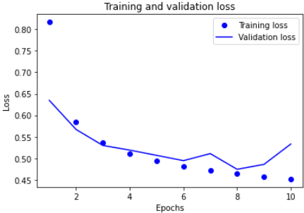
Inspecting the training
plot the loss for the training and validation sets using the plot_loss() function:

Slide 26
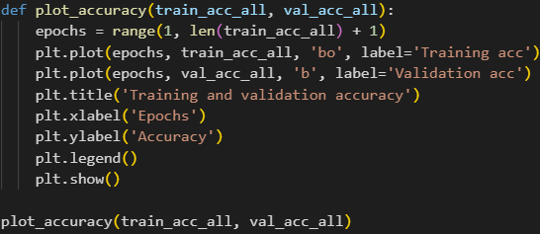
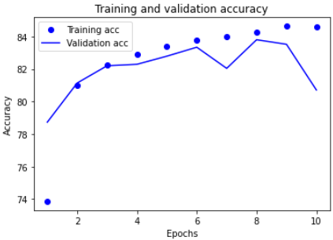
Inspecting the training
plot the accuracy for the training and validation sets using the plot_accuracy() function:

Slide 27

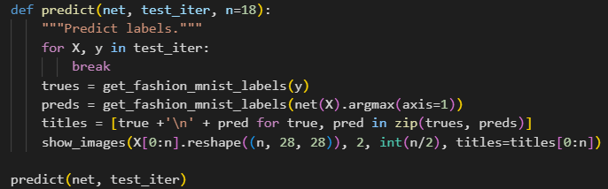
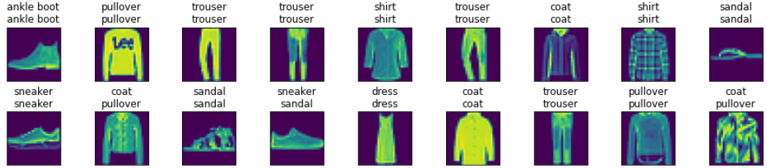
Finally evaluate the model
evaluate the trained model on the test set, which was not used at all during the training process:
we can also use our model to classify some images. Given a series of images, we will compare their actual labels (first line of text output) and the predictions from the model (second line of text output):
already done in lab
NOTE: get_fashion_mnist_labels() and show_images() functions are already done in FashionMNIST dataset section

Slide 28
4) Multilayer perceptrons

Slide 29

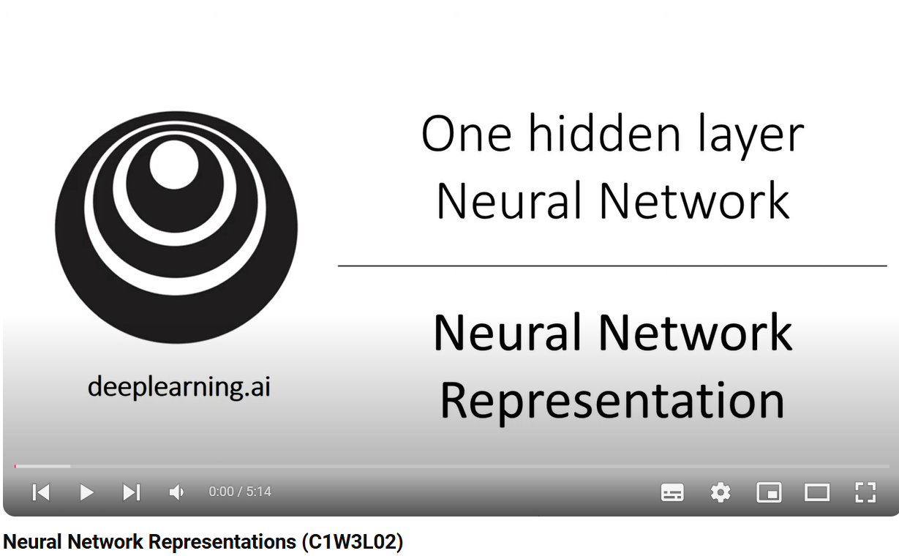
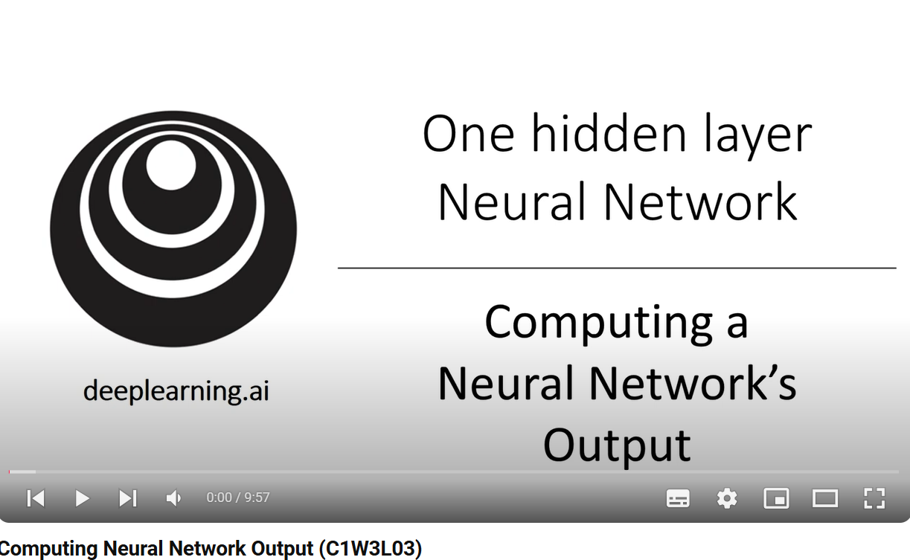
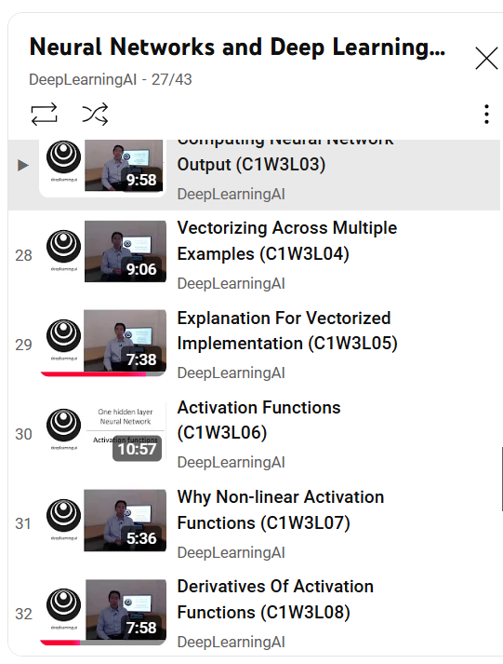

…or easier:

Slide 30
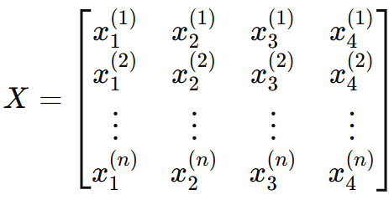
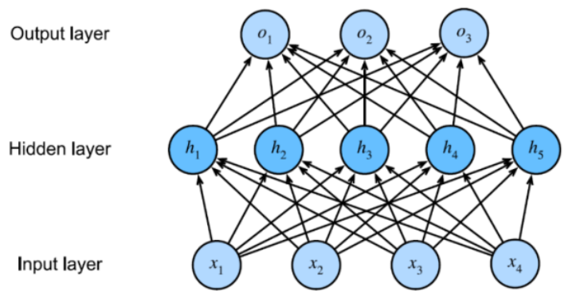
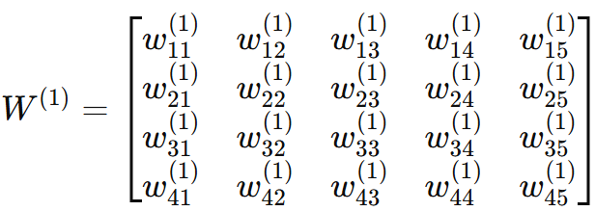





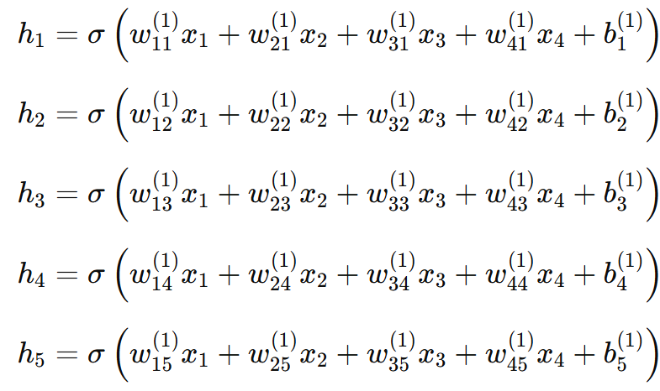





A simple example
nodes/neurons
bias – usually we don’t represent it in the diagrams
b⁽¹⁾
weights – the knowledge of the neural network
activation function (we will discuss about it in a moment)

Slide 31
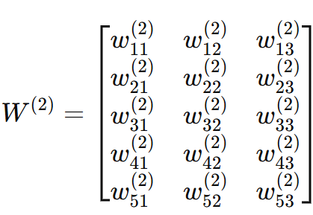





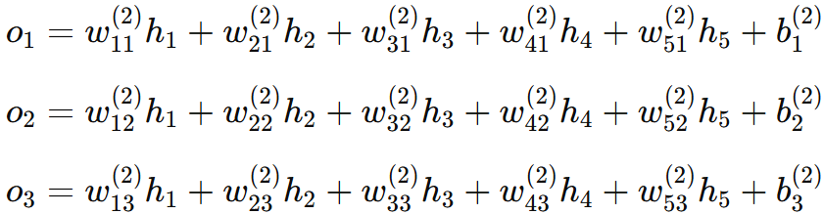



A simple example
weights – the knowledge of the neural network
bias – usually we don’t represent it in the diagrams
b⁽²⁾
nodes/neurons

Slide 32
















































































A simple example
b⁽²⁾
b⁽¹⁾
We want to find these !

Slide 33

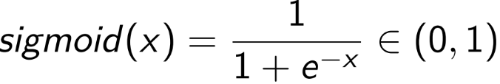
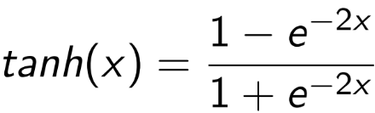
Some notes
the number of neurons per hidden layer and the number of hidden layers
hyperparameters that we need to decide about them
some of the most used activation functions ( ):
- rectified linear unit
- hyperbolic tangent

Slide 34


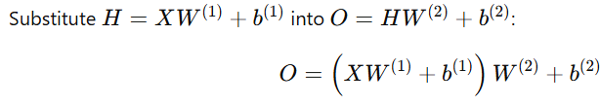



Why should we use activation functions?
Suppose we don’t use the activation function :

Slide 35



Why should we use activation functions?
Conclusion: this is equivalent to a single-layer linear model. As a result, no matter how many layers you stack, the model would be limited to learning linear relationships in the data
activation functions introduce non-linearity into the model. By applying a non-linear activation function (like ReLU, sigmoid, or tanh) to H, the model can learn non-linear patterns

Slide 36
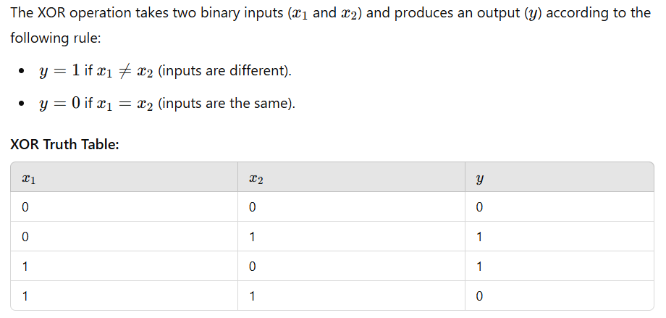
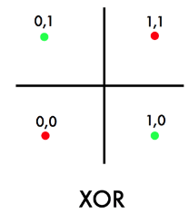
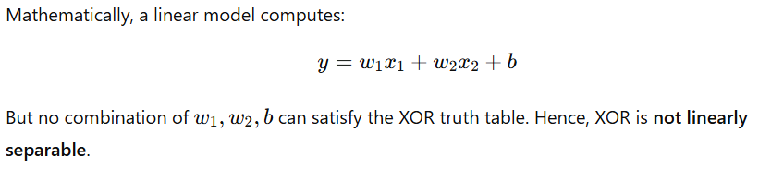


Example: the XOR problem

Slide 37
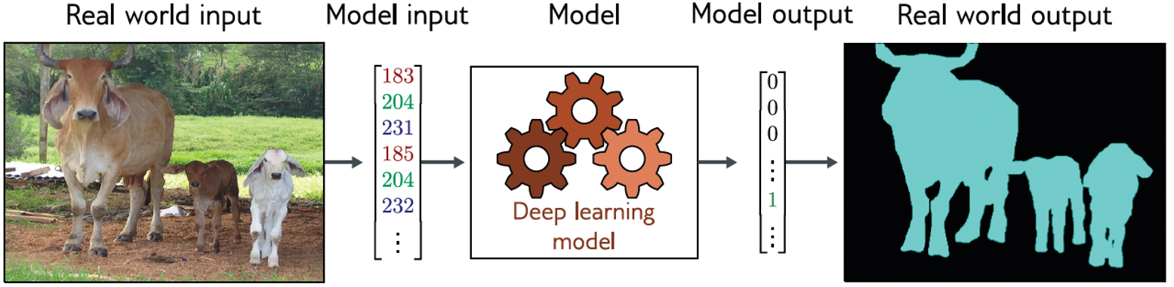
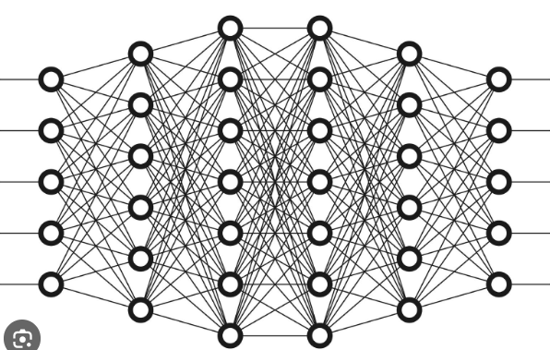




Example of problems
Image segmentation (semantic segmentation):
MLP
Depth estimation:
MLP
Image classification:
MLP

Slide 38


Example of problems
Translation:
MLP
Text classification:
MLP

Slide 39
NOTE
Even though the previously mentioned problems can be solved using MLPs, it is more appropriate to choose and use CNNs (for images) or RNNs (for text) to address them (as we will see in the next two labs) !

Slide 40
Code part

Slide 41





256×64 weights
64×10
weights
784×256 weights

Slide 42





Softmax regression from the second section of the lab
Softmax regression with an increased network

Slide 43
5) Weight decay

Slide 44

Kind reminder: overfitting vs underfitting
Underfitting occurs when a model is too simple to capture the underlying patterns in the data. It means the model does not fit the training data well and has high bias but low variance, resulting in poor performance on both training and test datasets.
Overfitting happens when a model is too complex and fits the training data "too well," even capturing noise and random fluctuations. As a result, it has low bias but high variance—it performs very well on the training data but poorly on unseen data because it lacks generalization

Slide 45






it simply adds a penalty term to the loss function
for example, consider the MSE loss given by:
for the model below, the "new" loss function will be:
penalty term

Slide 46
Code part

Slide 47

because weight decay is ubiquitous in neural network optimization, PyTorch makes it especially convenient, integrating weight decay into the optimization algorithm itself, for easy use in combination with any loss function:
that’s all

Slide 48

Softmax regression with an increased network and weight decay applied
Softmax regression from the second section of the lab

Slide 49
6) Dropout

Slide 50
Dropout steps
dropout is a regularization technique commonly used in neural networks to prevent overfitting
it works by randomly "dropping out" (setting to zero) a subset of neurons during training, effectively forcing the network to not overfit to specific neurons or weights
at each training iteration, for each hidden neuron, decide whether to "drop" it based on a predefined dropout rate, 𝑝 (a probability value between 0 and 1)
for a dropout rate 𝑝, each neuron is retained with a probability 1 − 𝑝. This decision is made independently for every neuron in the layer
the neurons that are "dropped out" have their activations set to zero for that iteration.

Slide 51
Dropout steps
example: if 𝑝 =0.2, each neuron has an 80% chance of being retained and a 20% chance of being dropped
to maintain the expected value of the layer's output unchanged, the retained neurons' activations are scaled by 1/(1− 𝑝)
during inference, dropout is not applied
instead, the weights of all neurons are scaled down by (1− 𝑝). This ensures that the output remains consistent with the effective behavior during training, where only a fraction of the neurons were active at a time

Slide 52






Slide 53





Slide 54
Code part

Slide 55

all we need to do is add a nn.Dropout layer after each fully-connected layer, passing in the dropout probability as the only argument to its constructor
during training, the nn.Dropout layer will randomly drop out outputs of the previous layer (or equivalently, the inputs to the subsequent layer) according to the specified dropout probability
in the example below, we will drop 20% of the outputs of the first hidden layer, and 30% of the outputs of the second hidden layer
when not in training mode, the nn.Dropout layer simply passes the data through, during testing

Slide 56


Softmax regression with an increased network and dropout applied
Softmax regression from the second section of the lab

Slide 57


Slide 58
7) Deep learning computation

Slide 59



if we deal with complex neural networks, we will need to work with blocks (classes):
inspect the parameters (weights and biases – w and b) of the neural network:
AICI E MIEZUL !
Here we implement the behaviour/logic of the network

Slide 60



put the model on the GPU if the GPU is available:

Slide 61
Old Exercises
(same as for PI)

Slide 62



Slide 63




Solutions
go back to slide 11 to see the difference between epoch and iteration ☺
the generated sequence will be: -3.0, -2.9, -2.8,…2.9
it results in 60 values in total because the range spans from -3 to 2.9 with steps of 0.1
X = torch.linspace(-3, 3, steps=num_examples * len(w)).reshape(num_examples, len(w)) -> this is an alternative which creates a 1D tensor with steps evenly spaced between -3 and 3 (inclusive)

Slide 64




Slide 65





Slide 66




NOTE:
if we had specified epochs instead of iterations in the statement we would have had the following solution:

Slide 67



construct the MNIST dataset and access it in mini-batches:

Slide 68



define the softmax regression model:
initialize the parameters:
specify the loss function to be used:
specify the optimizer to be used:

Slide 69
use the evaluate_accuracy() function which is already done in lab:

Slide 70
use train_epoch() function which is already done in lab:
use train() function which is already done in lab:
train the model for 1 epoch
train the model for multiple epochs, specified by num_epochs

Slide 71

train the model for 15 epochs by running train() function:

Slide 72

plot the loss for the training and validation sets using the plot_loss() function:

Slide 73

plot the accuracy for the training and validation sets using the plot_accuracy() function:

Slide 74


evaluate the trained model on the test set, which was not used at all during the training process:
use our model to classify some images. Given a series of images, we will compare their actual labels (first line of text output) and the predictions from the model (second line of text output):
function already done in lab at FashionMNIST dataset section (slide 14)

Slide 75




adaptation of get_fashion_mnist_labels() function from FashionMNIST dataset section (slide 14)

Slide 76



construct the MNIST dataset and access it in mini-batches:

Slide 77


define the softmax regression model:
initialize the parameters:
specify the loss function to be used:
specify the optimizer to be used:

Slide 78
use the evaluate_accuracy() function which is already done in lab:

Slide 79
use train_epoch() function which is already done in lab:
use train() function which is already done in lab:
train the model for 1 epoch
train the model for multiple epochs, specified by num_epochs

Slide 80

train the model for 15 epochs by running train() function:

Slide 81

plot the loss for the training and validation sets using the plot_loss() function:

Slide 82

plot the accuracy for the training and validation sets using the plot_accuracy() function:

Slide 83

evaluate the trained model on the test set, which was not used at all during the training process:
use our model to classify some images. Given a series of images, we will compare their actual labels (first line of text output) and the predictions from the model (second line of text output):
function already done in lab at FashionMNIST dataset section (slide 14)

Slide 84
adaptation of get_fashion_mnist_labels() function from FashionMNIST dataset section (slide 14)

Slide 85
New Exercises

Slide 86



Slide 87


Solutions

Slide 88


Slide 89




Slide 90





this is the solution using PyTorch’s predefined layers

Slide 91



construct the Imagenette dataset and access it in mini-batches:

Slide 92

define the softmax regression model:
initialize the parameters:
specify the loss function to be used:
specify the optimizer to be used:

Slide 93
use the evaluate_accuracy() function which is already done in lab:

Slide 94
use train_epoch() function which is already done in lab:
use train() function which is already done in lab:
train the model for 1 epoch
train the model for multiple epochs, specified by num_epochs

Slide 95


train the model for 5 epochs by running train() function:
Why such poor performance?
See exercise 3! – slide 101

Slide 96


plot the loss for the training and validation sets using the plot_loss() function:

Slide 97

plot the accuracy for the training and validation sets using the plot_accuracy() function:

Slide 98



evaluate the trained model on the test set, which was not used at all during the training process:
use our model to classify some images. Given a series of images, we will compare their actual labels (first line of text output) and the predictions from the model (second line of text output):
function already done in lab at FashionMNIST dataset section (slide 14)
I changed only this because the valid shapes for ax.imshow() are:
  grayscale images: (H,W)
  RGB images: (H, W, 3)

Slide 99




adaptation of get_fashion_mnist_labels() function from FashionMNIST dataset section (slide 14)

Slide 100


construct the Imagenette dataset and access it in mini-batches:

Slide 101

the network from exercise 3 gradually reduces the dimensionality of the feature space (e.g., 90000 → 128 → 128 → 128 → 128). This helps the network focus on important features step-by-step and avoid overwhelming the final layer with too many irrelevant details
the network from exercise 2 directly maps 90,000 inputs to 10 outputs, which can lead to poor weight updates because of noisy gradients and insufficient abstraction
net used here for exercise 3 vs net used in exercise 2
the network from exercise 3 includes ReLU activation functions after each layer, introducing non-linearity. This allows the model to capture more complex relationships between features dropout for regularization
the network from exercise 2 is entirely linear, which limits its ability to model complex data distributions. A purely linear model assumes that the data can be separated by straight hyperplanes, which is unrealistic for image data
the rest is the same as in exercise 2 (excepting learning rate and number of epochs)

Slide 102


NOTE: training for only 5 epochs is often insufficient for models to converge, particularly when starting with random initialization and training from scratch on a complex dataset like Imagenette

Slide 103
Thank you !

